Slide 1

Sentiment Analysis
By Anshu Pathak Amlan Raja Prashant Chaudhary

Slide 2

What is sentiment analysis?
The process of computationally identifying and categorizing opinions expressed in a piece of text, especially in order to determine whether the writer's attitude towards a particular topic, product, etc. is positive, negative, or neutral.

Slide 3

About the Data
Extracted around 11K tweets using Twitter Search API/Twitter 4J API
Zeroed in on the hashtags(#) for the top 5 teams in the current season
Applied data cleaning techniques such as converting all text to lower case, removal of blank space, hyperlinks, punctuations and stop words
Analyzed the sentiments of the users behind the tweets based on the NRC Word-Emotion Association Lexicon
Teams – Real Madrid, Barcelona, Atletico Madrid, Valencia, Sevilla

Slide 4

Most Tweeted Team

Slide 5

Tweets Around the Globe

Slide 6
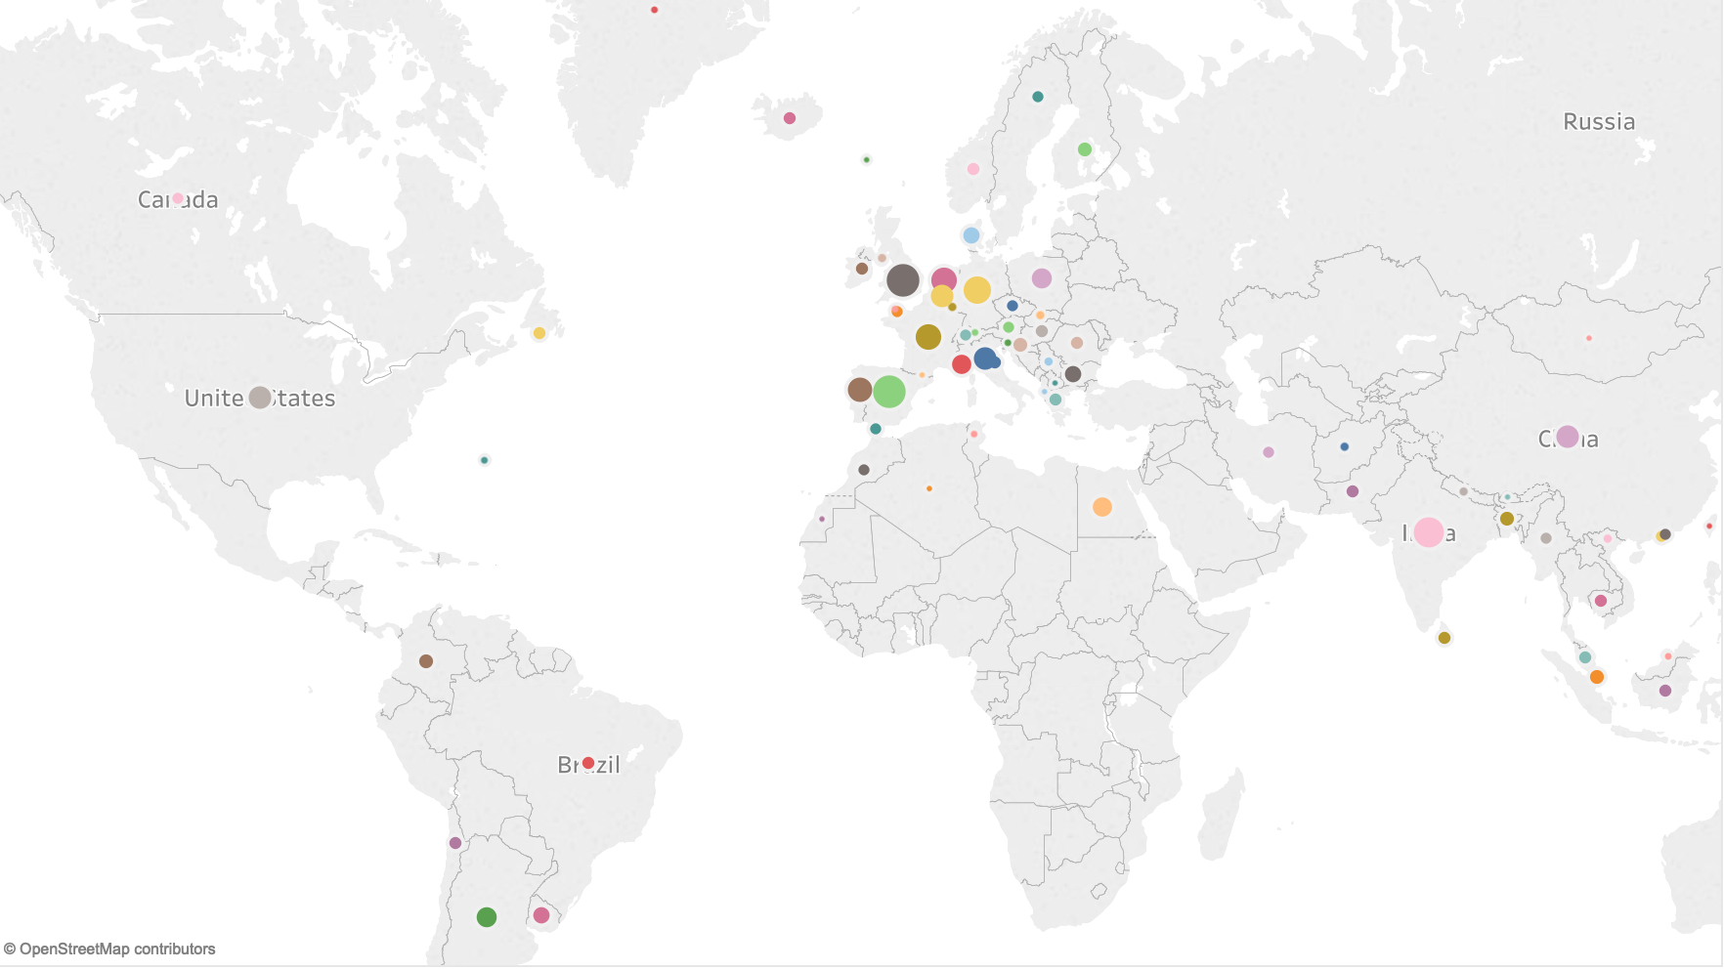

Slide 7
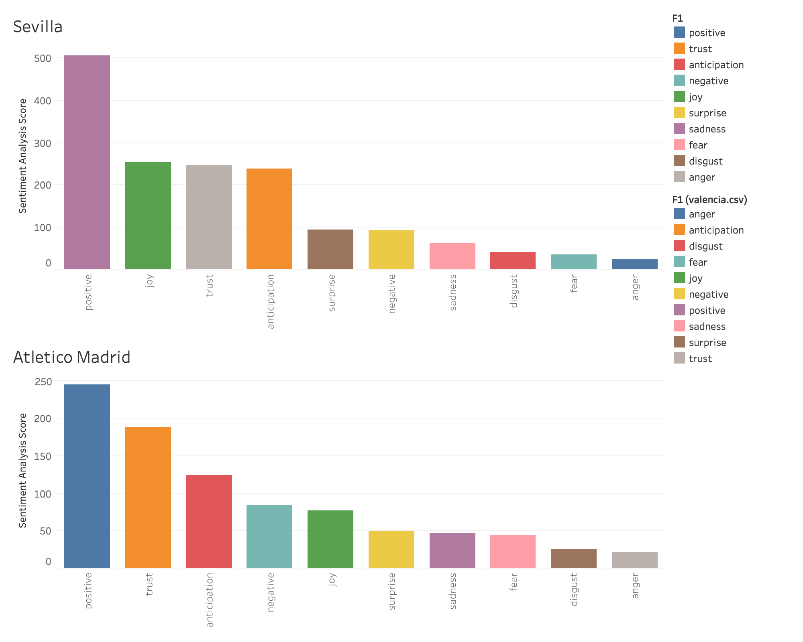
Sentimental Scores

Slide 8
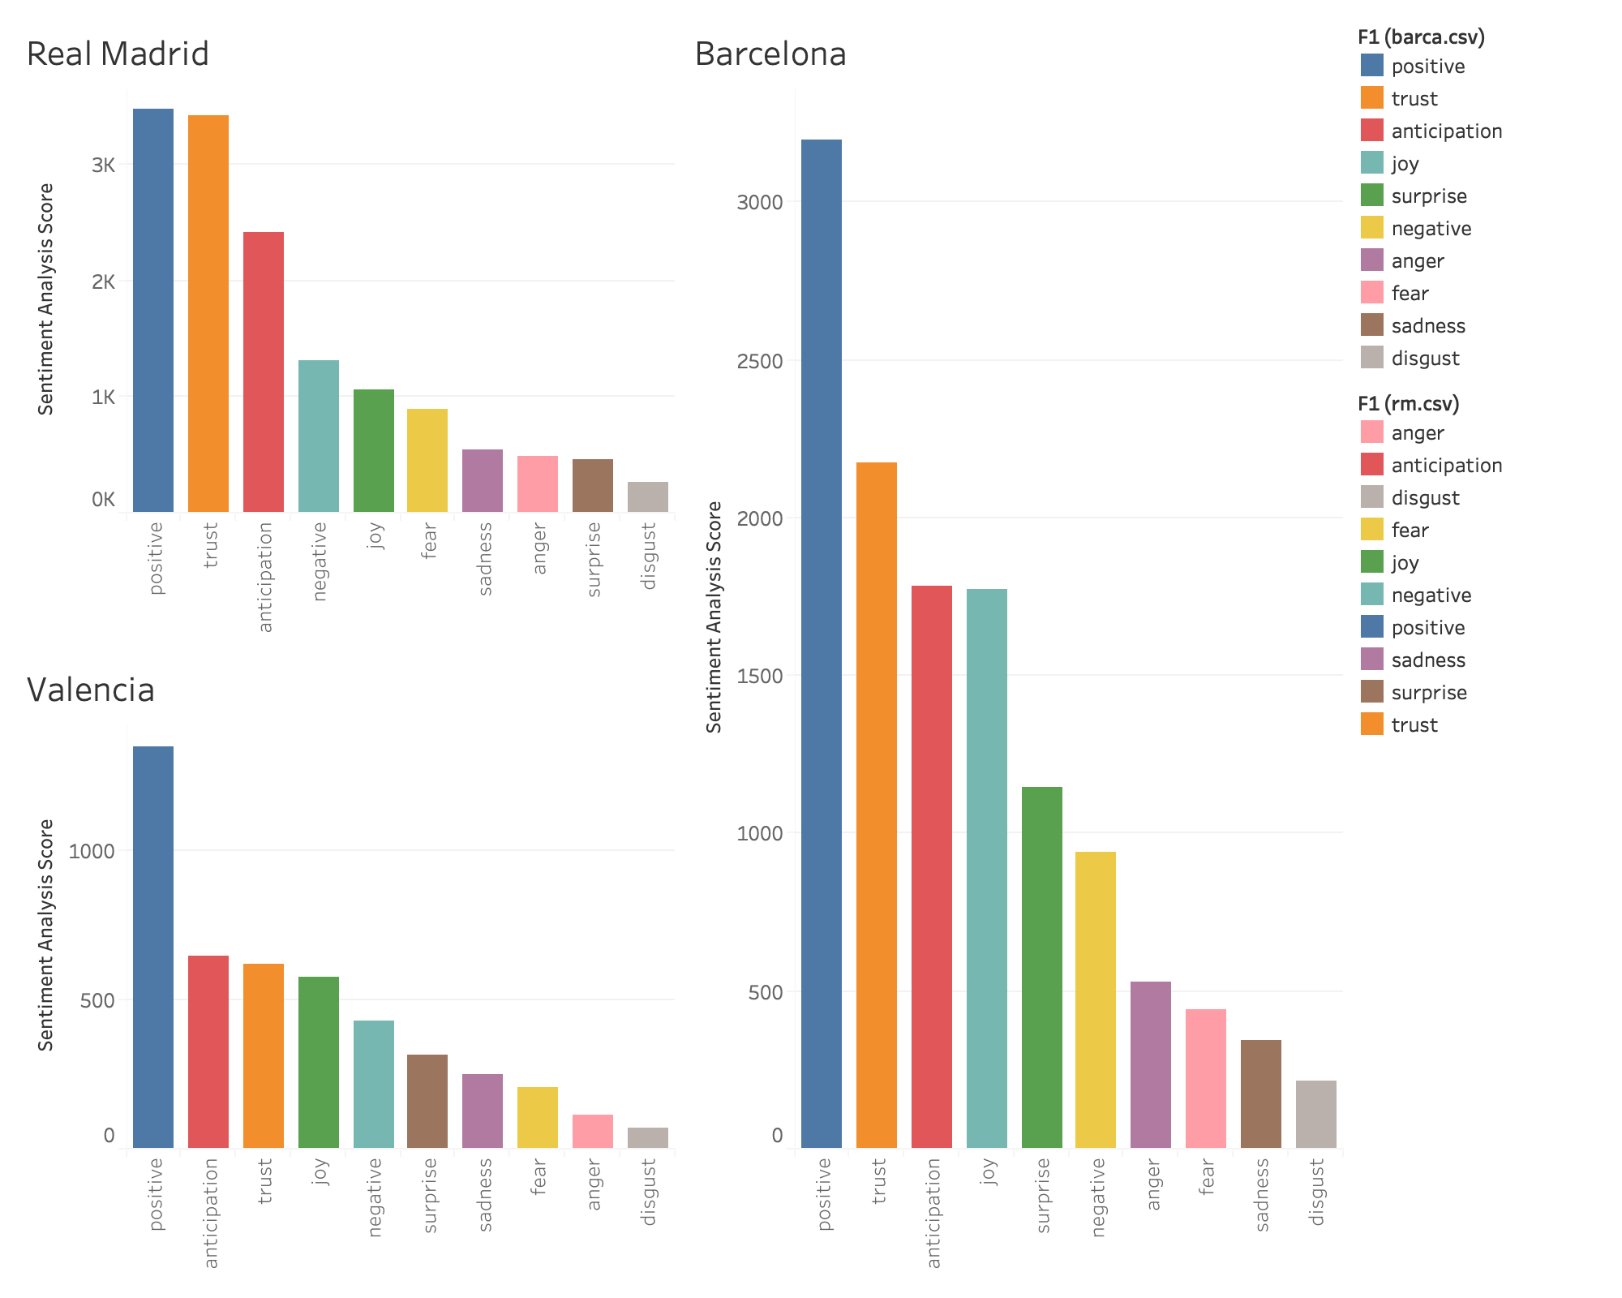

Slide 9

Thank You

